Slide 1


Webscraping Nasdaq.com
With Scrapy
Cameron Wisdom
+

Slide 2
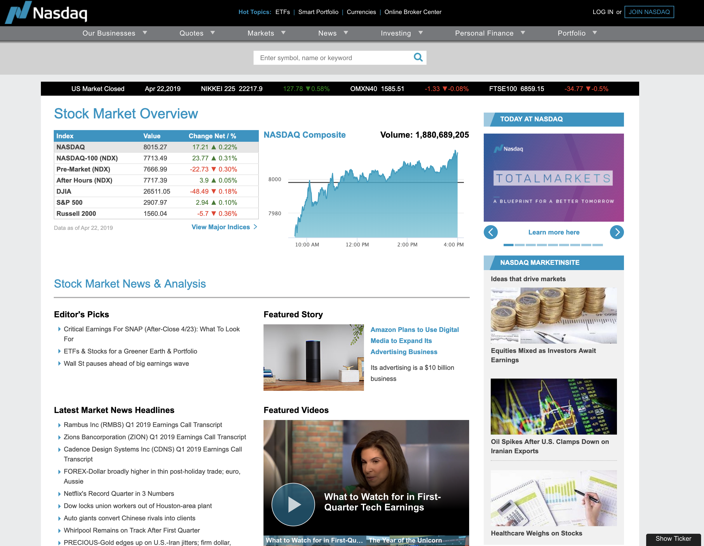
Background
2nd largest stock exchange in the world by Market Cap
World’s first electronic Stock Market
Notable listings include: Microsoft, Oracle, Apple, Cisco, and Dell
Helped modernize the IPO

Slide 3
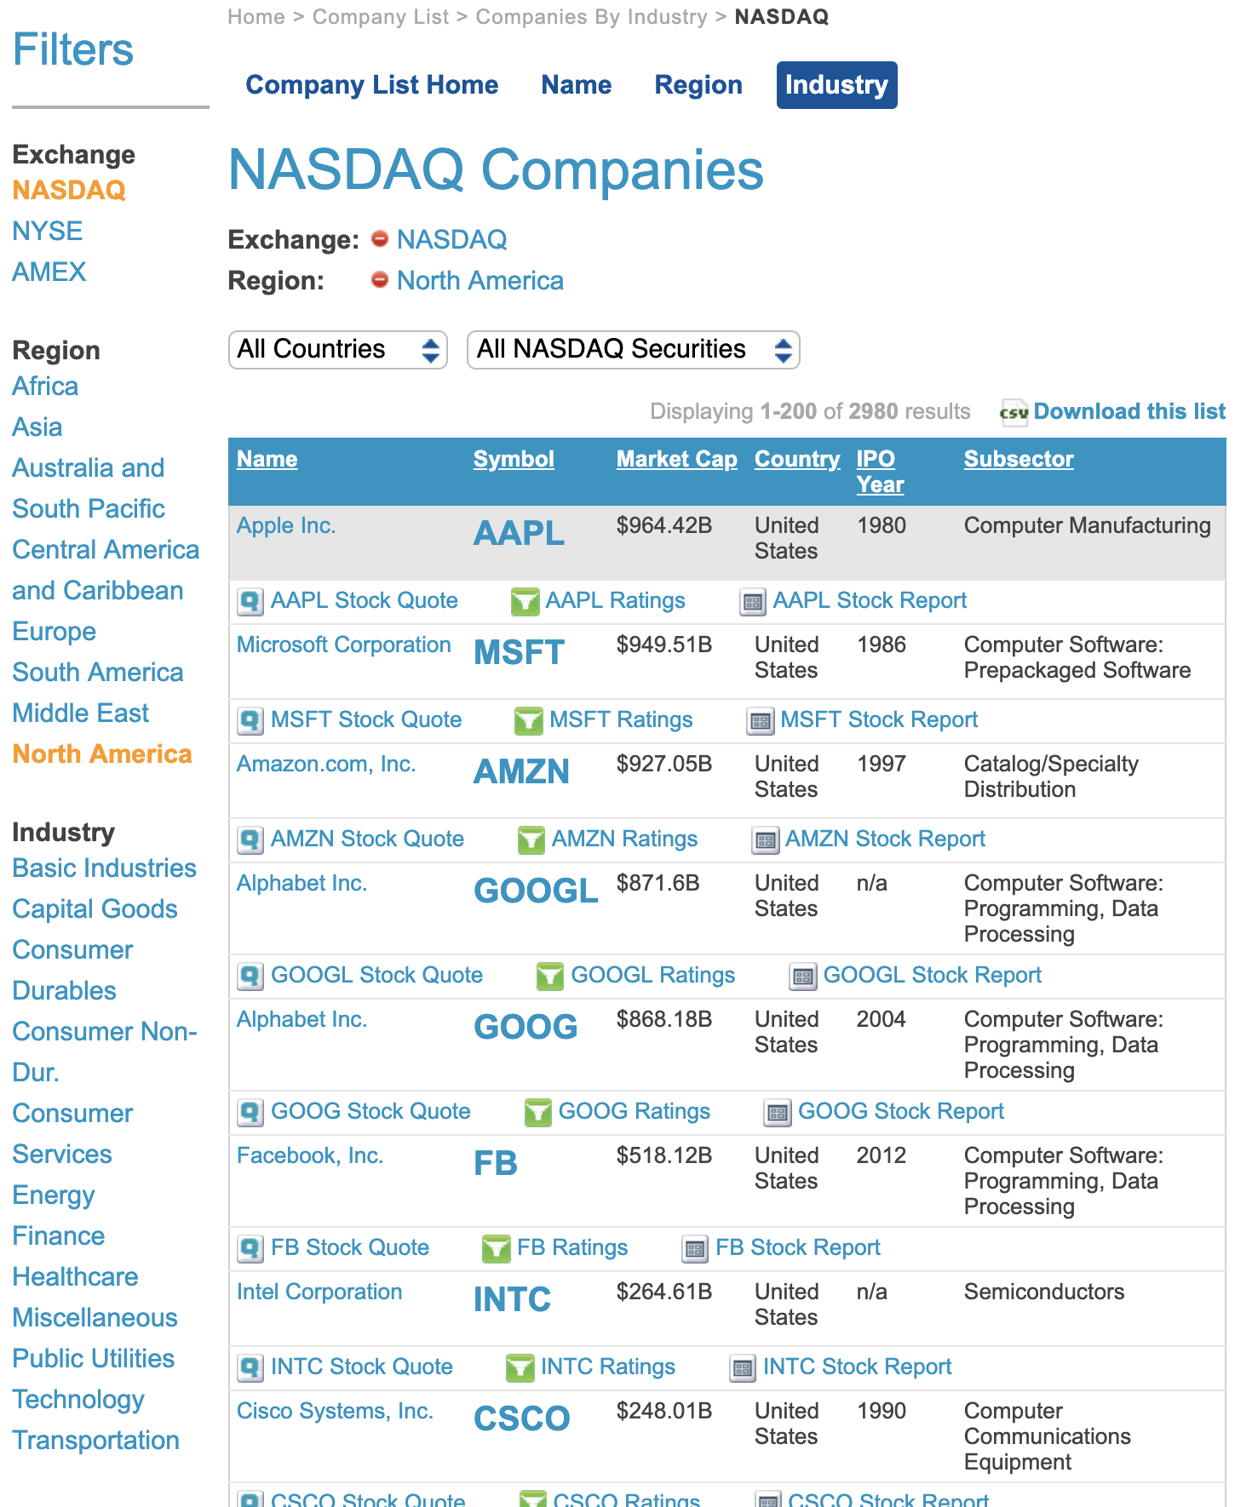
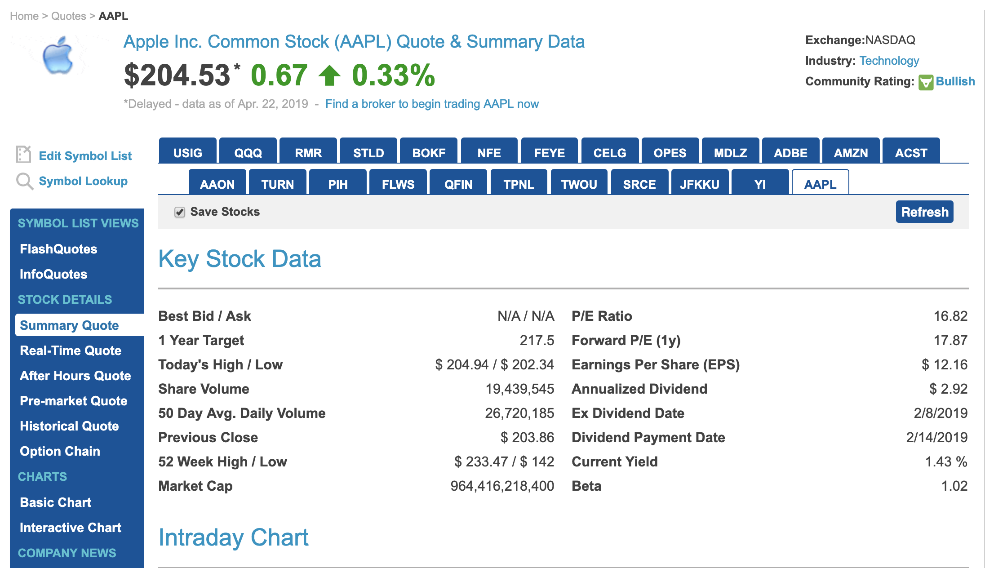
This lovely table is dynamic and changes throughout each day during trading hours.
Interestingly enough, it also omits cells if the information is not available. yay!
Index Page
1 of 15
summary page

Slide 4





The right tools for the job
Jupyter notebook
Pycharm
Github Desktop
ROBOTSTXT_OBEY = False
NordVPN
Caffeine
Selector Gadget
Youtube
“Hey Siri, how do I export graphs from jupyter notebook? Asking for a friend”

Slide 5
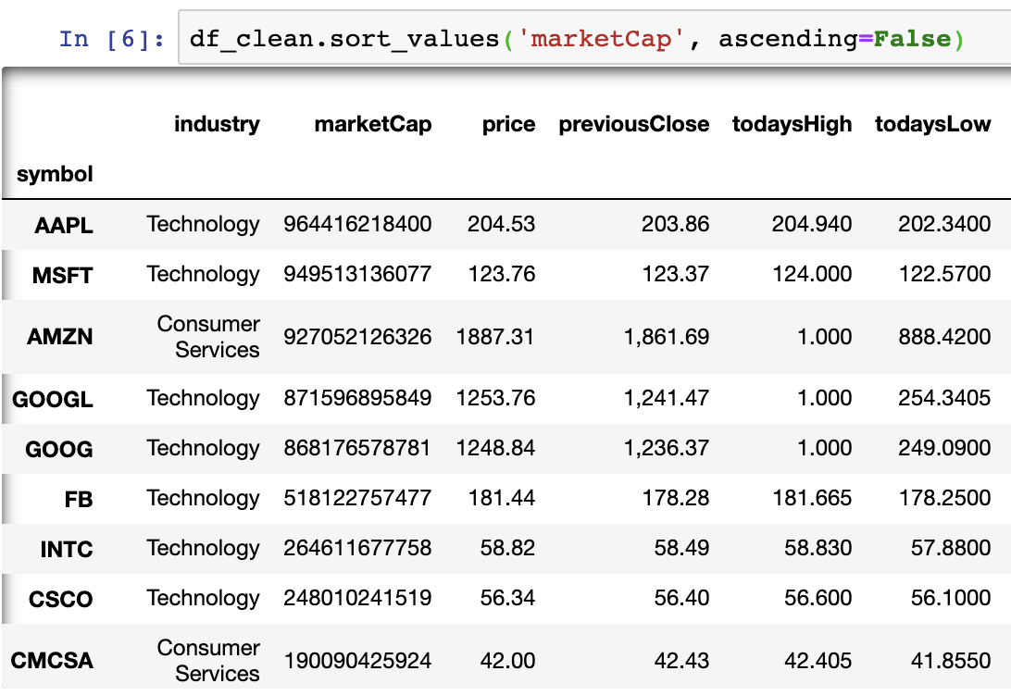


Slide 6

That’s… Interesting
WHY?

Slide 7
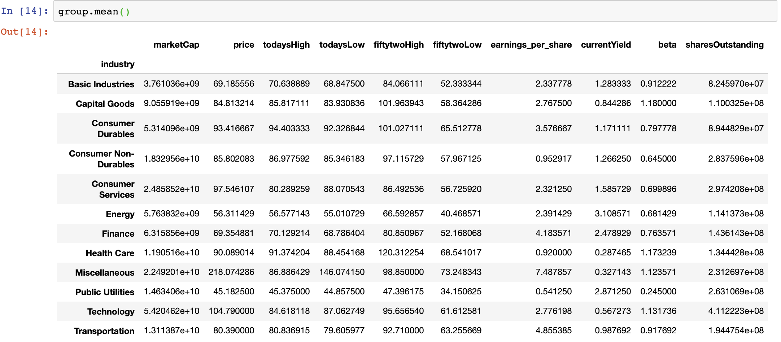

Slide 8
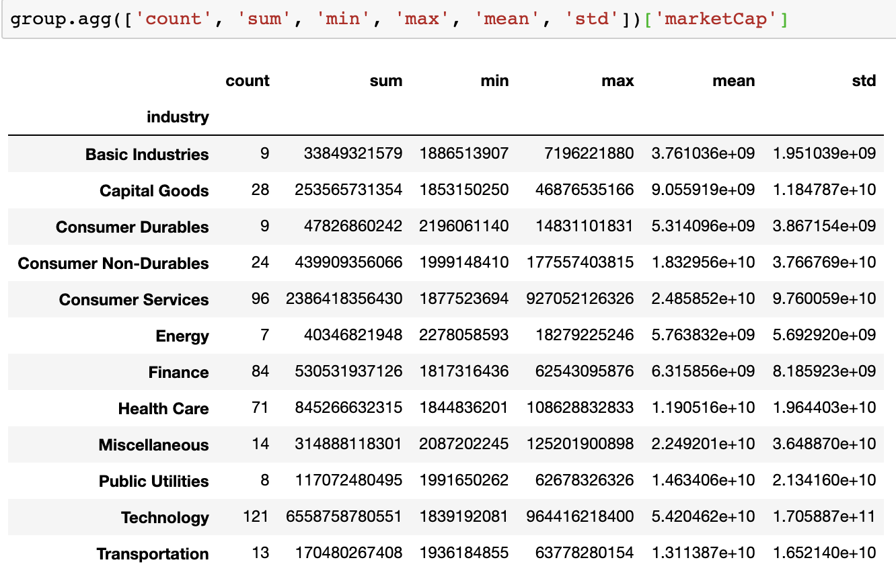

Slide 9
$24.1 billion
Mean Market Capitalization value of the top 500 listings on Nasdaq

Slide 10
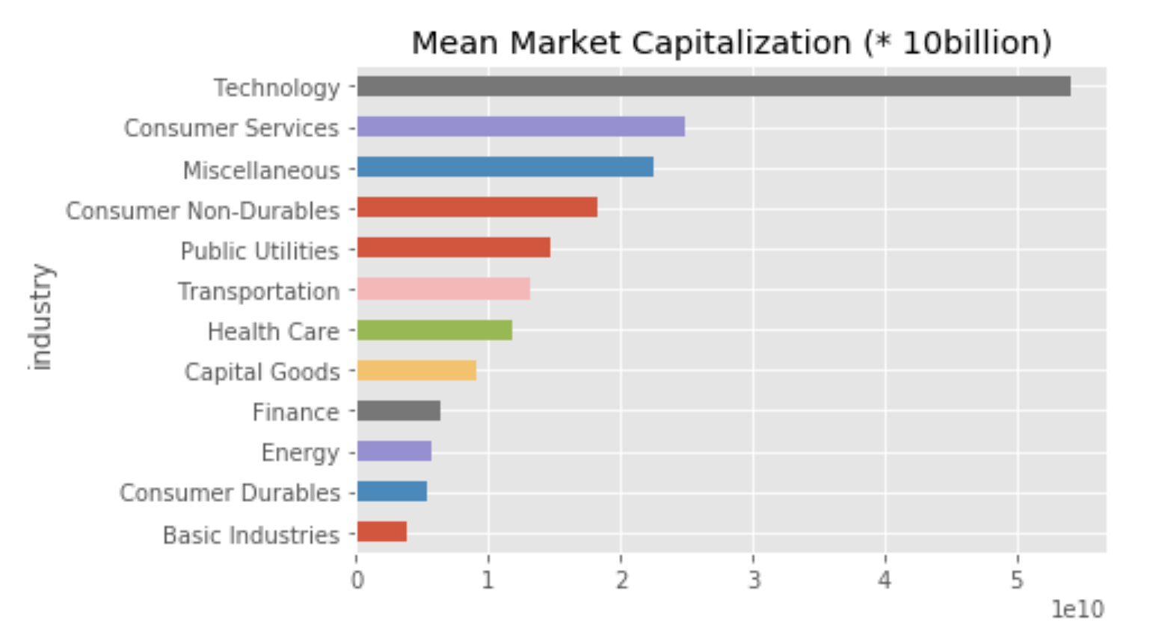

Slide 11
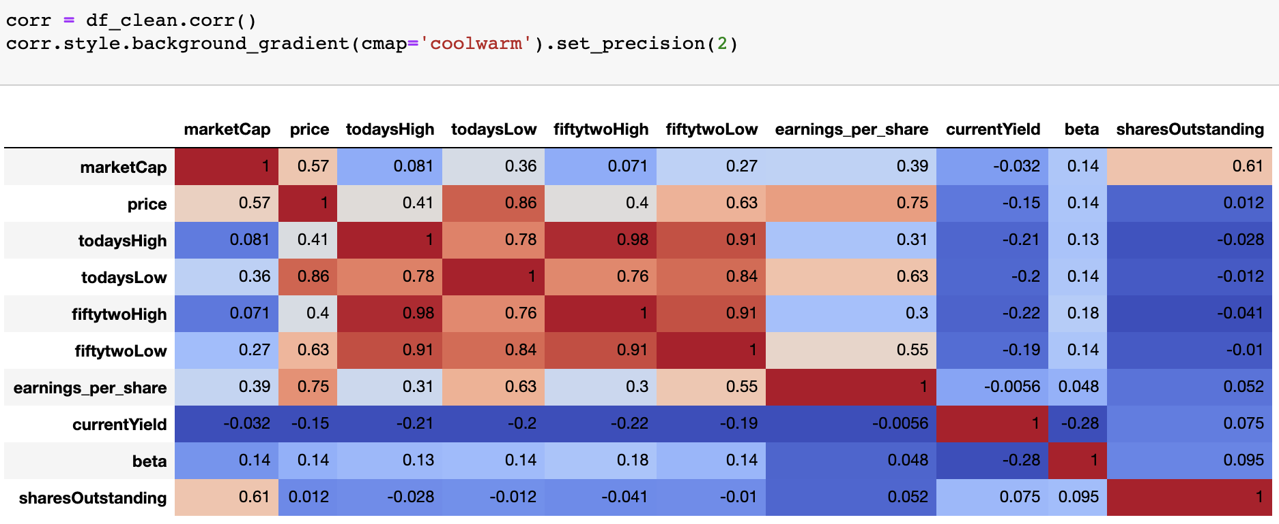
Colors indicate correlation relationship (+ or -), darker hues indicate correlation strength

Slide 12
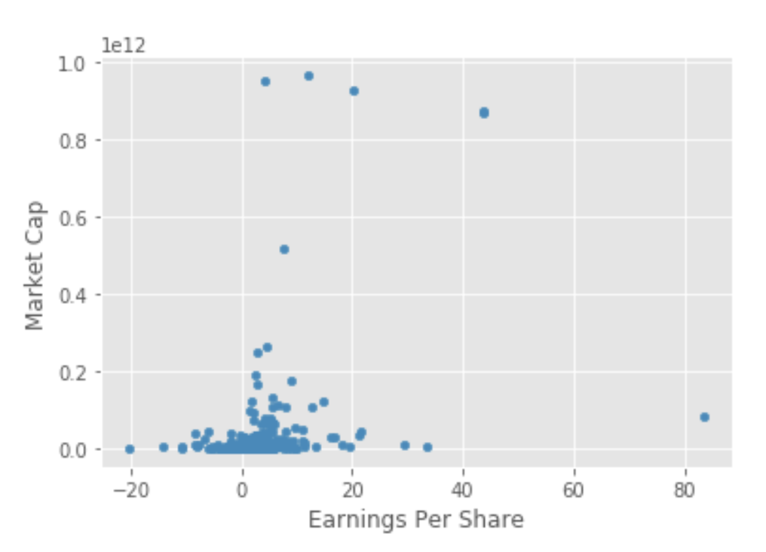
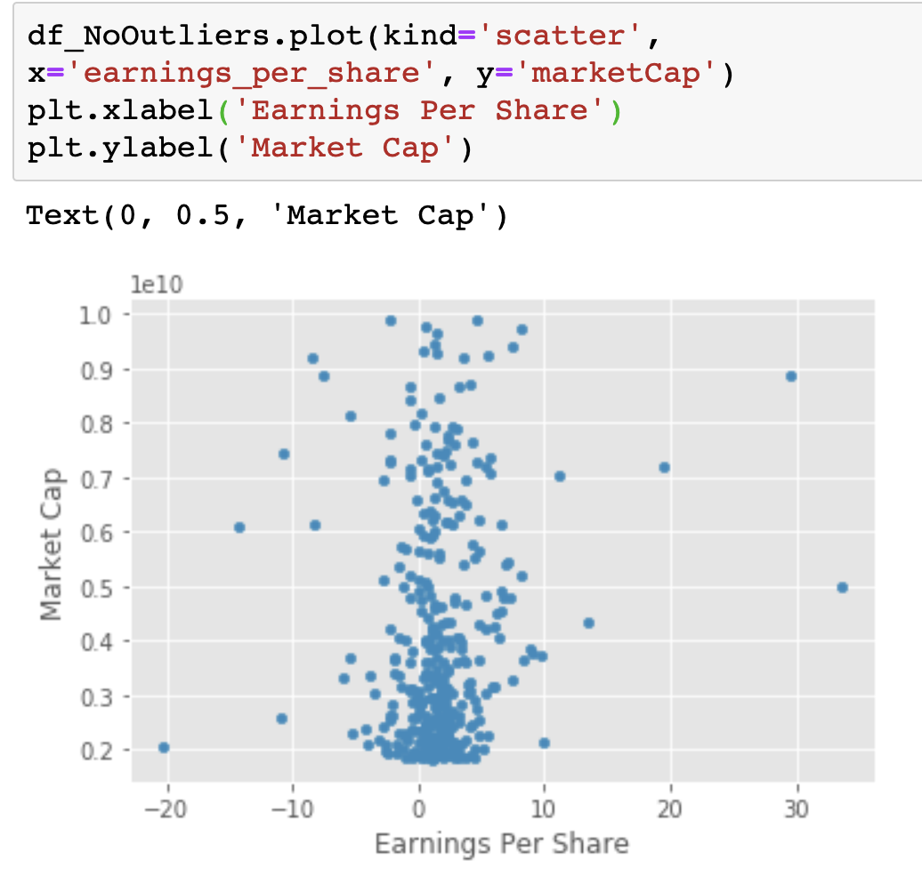
WARNING: Outliers will skew your data

Slide 13
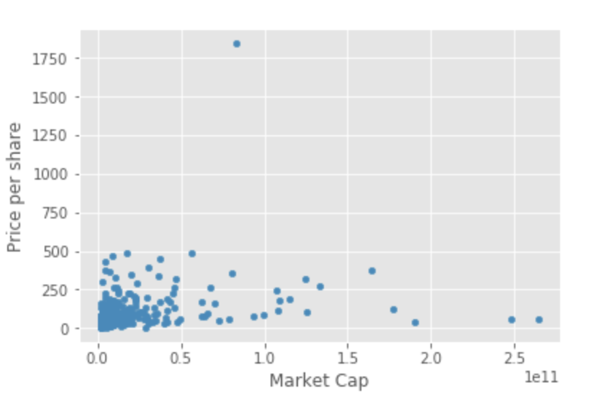
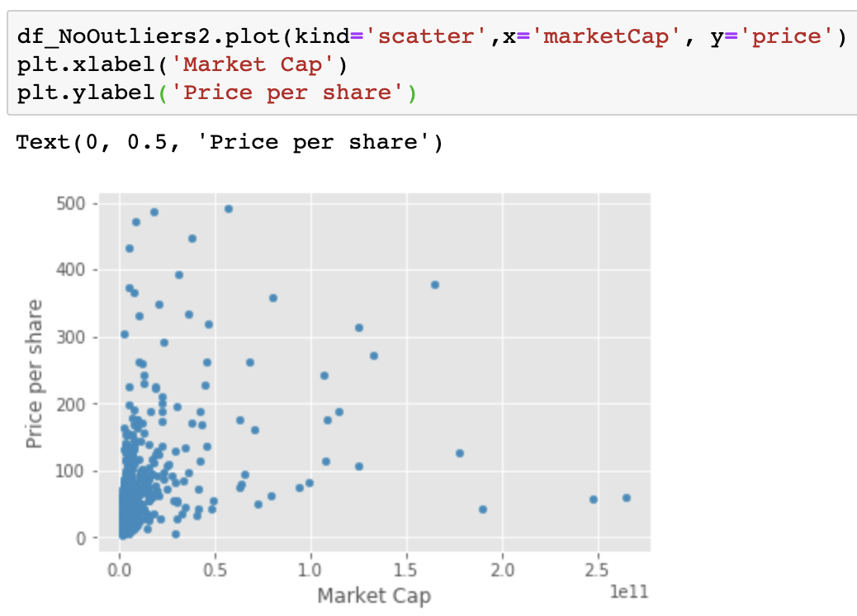

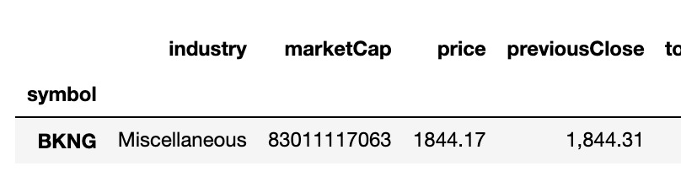
Outliers 2: the skewed dataset strikes back

Slide 14
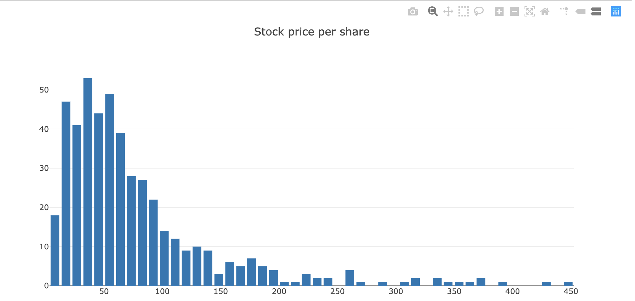
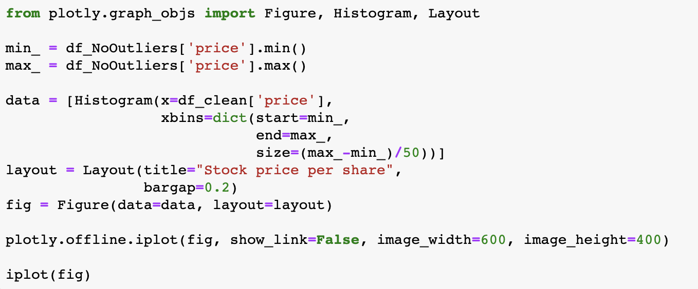
“Look at that neato right-skewed distribution!” - Stats Professor probably

Slide 15
In Conclusion
“With exception to the variables that track security pricing listed on the Nasdaq website, there is little correlation between the remaining variables to serve as a predictor of one another. However, the dynamic data provided is far too prone to erroneous observations to draw significant conclusions.”

Slide 16
fin
Any questions?

